Slide 1
Time Series Data Cleaning: From Anomaly Detection to Anomaly Repairing
汇报人：魏伯繁
汇报时间：2022年9月22日

Slide 2
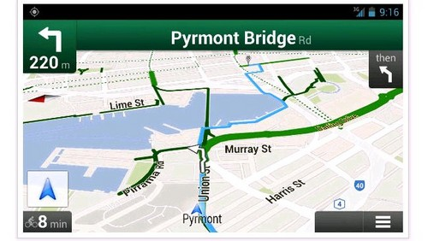
Time series data
1、Errors are prevalent in time series data, such as GPS trajectories
2、By simply filtering out the dirty data via anomaly detection, applications could still be unreliable over the incomplete time series.

Slide 3
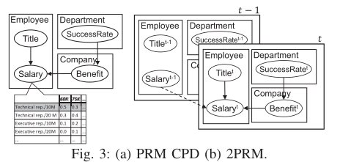
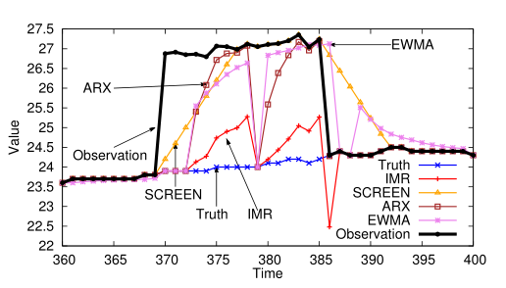
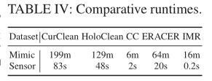
compare with currentclean
1、Compare with currentclean
multiple types of data single type data

Slide 4
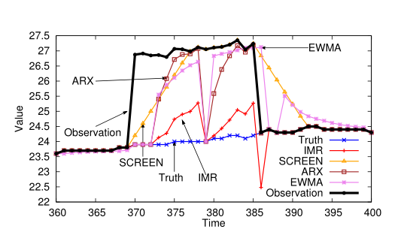
related work--SCREEN
A data point is considered as anomaly if its predication significantly differs from observation.
Unfortunately,noisy/erroneous data are often
close to the truth in practice, under the intuition
that human or systems always try to
minimize their mistakes

Slide 5
related work--SCREEN
constraint-based repairing SCREEN strictly following the minimum change principle in data repairing
The repairing is performed based on two consecutive points, considering only one historical point,and thus does not sense the temporal nature of errors.
effective in repairing spike errors

Slide 6
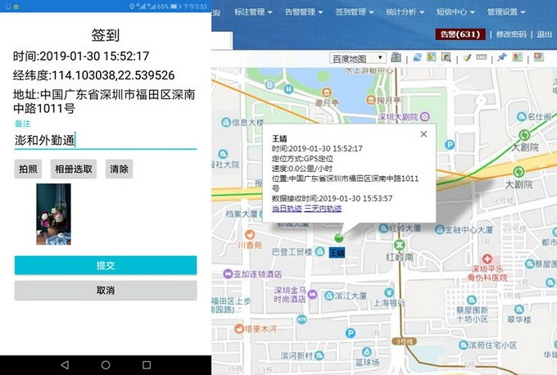
completely automatic data repairing？
utilizing master data (a single repository of high-quality data) in data repairing
labeled truth

Slide 7
The core of IMR
IMR minimally changes one point a time to obtain the most confident repair only
The high confidence repairs, together with the labeled truth of error points

Slide 8
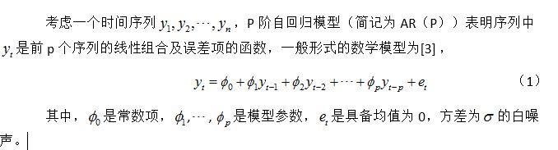


previous-AR
Autoregressive Model

Slide 9
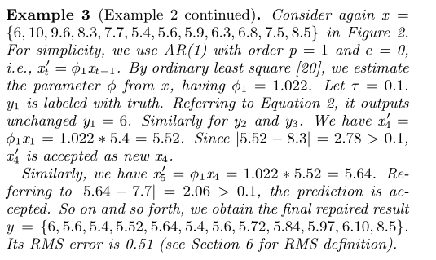
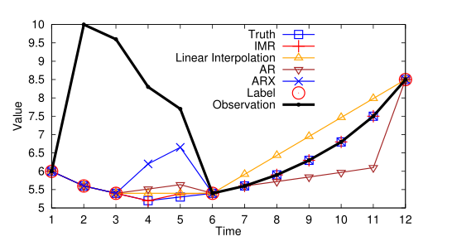
example--AR model
observe：{6, 10, 9.6, 8.3, 7.7, 5.4, 5.6, 5.9, 6.3, 6.8, 7.5, 8.5}
need repair：{6, 5.6, 5.4, --,--, 5.4, --,--, --, --, --, 8.5}
p = 1 ，c = 0，φ1 = 1.022，τ = 0.1.
x ′4 =φ1x1 = 1.022 *5.4 = 5.52.
|5.52 − 8.3| = 2.78 > 0.1,
x ′4 is accepted as new x4.
y = {6, 5.6, 5.4, 5.52, 5.64, 5.4, 5.6, 5.72, 5.84, 5.97, 6.10, 8.5}.

Slide 10

previous-ARX
not only the preceding observations xt−i will affect the determination of y ′t, but also the previously labeled/repaired yt−i.

Slide 11
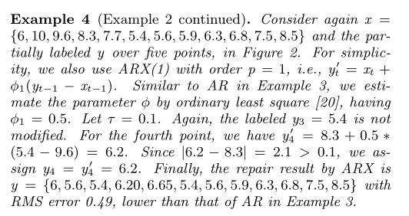
example--ARX model
observe：{6, 10, 9.6, 8.3, 7.7, 5.4, 5.6, 5.9, 6.3, 6.8, 7.5, 8.5}
need repair：{6, 5.6, 5.4, --,--, 5.4, --,--, --, --, --, 8.5}
p = 1 ，φ1 = 0.5，τ = 0.1.
y ′4 = 8.3 + 0.5 ∗(5.4 − 9.6) = 6.2.
Since |6.2 − 8.3| = 2.1 > 0.1, we assign y4 = y ′4 = 6.2.
y = {6, 5.6, 5.4, 6.20, 6.65, 5.4, 5.6, 5.9, 6.3, 6.8, 7.5, 8.5}

Slide 12
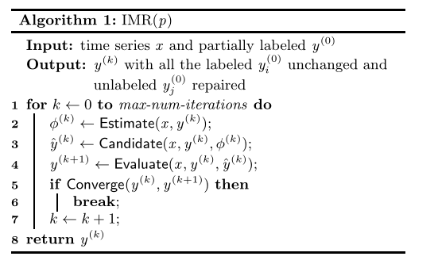
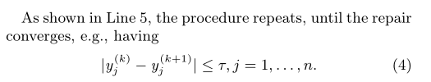
IMR ALG
输入一组部分真值的观察值序列
保持真值不变，更新所有其他值 达到最大迭代次数则退出
第一步：
计算本次迭代的参数值
第二步：选择一个最简候选更新值
第三步：将选择的候选值应用于更新
每一个点都收敛则退出

Slide 13
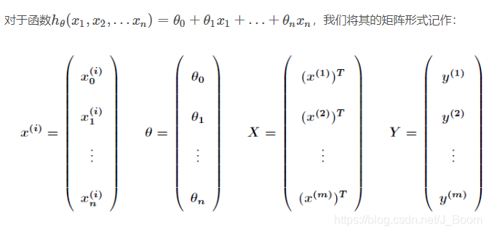
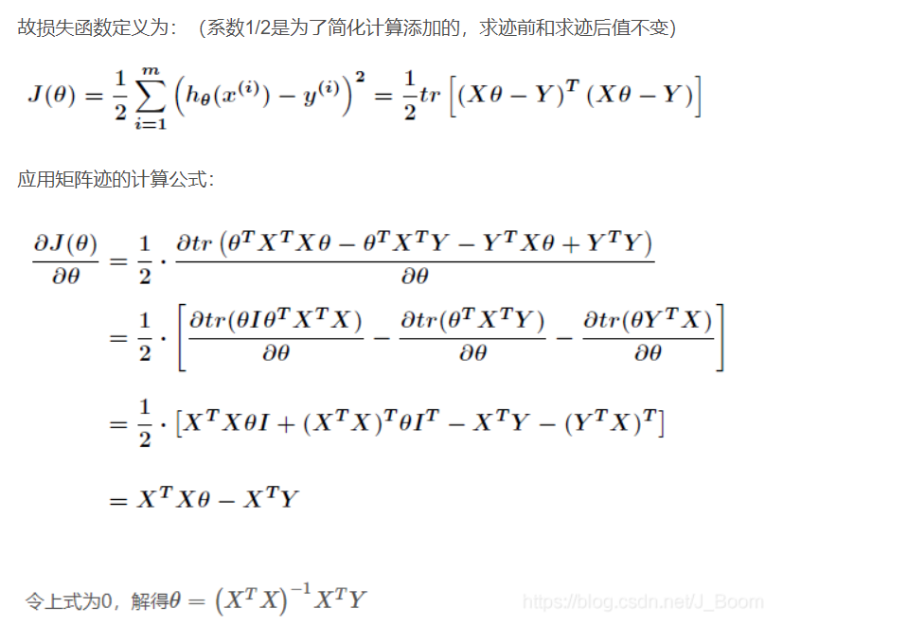
step1：Parameter Estimation
method：Ordinary Least Square
知乎网址：https://zhuanlan.zhihu.com/p/128083562

Slide 14
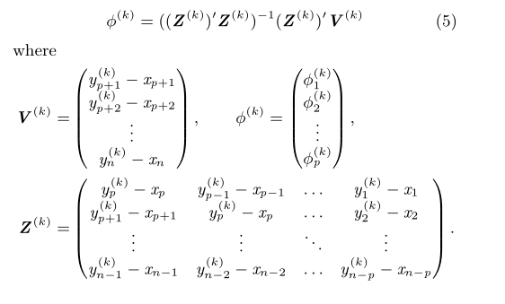
step1：Parameter Estimation
最终要拟合的点的y值，即为上一次迭代中预测值/真值与观察值的差
最后得到的参数矩阵
所对应的，在V矩阵中第i行的数据即由Z矩阵的第i行拟合而来

Slide 15
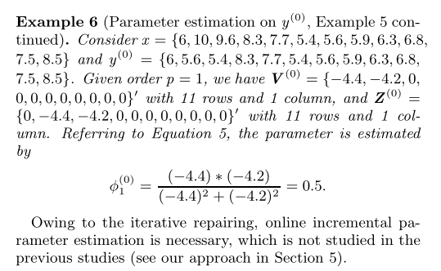


example：Parameter Estimation
observe：{6, 10, 9.6, 8.3, 7.7, 5.4, 5.6, 5.9, 6.3, 6.8, 7.5, 8.5}
y (0) = {6, 5.6, 5.4, 8.3, 7.7, 5.4, 5.6, 5.9, 6.3, 6.8,7.5, 8.5}
p=1
V (0) = {−4.4, −4.2, 0,0, 0, 0, 0, 0, 0, 0, 0}′（细节：从p+1开始取值）
Z (0) ={0, −4.4, −4.2, 0, 0, 0, 0, 0, 0, 0, 0}′（细节：最后一组不取）

Slide 16

step2：Candidate Generation
We note that only candidates with need to be considered

Slide 17
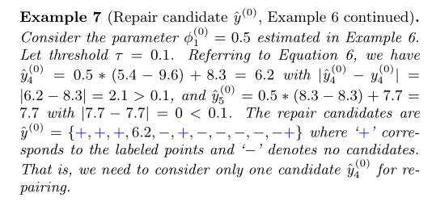
example：Candidate Generation
observe：{6, 10, 9.6, 8.3, 7.7, 5.4, 5.6, 5.9, 6.3, 6.8, 7.5, 8.5}
y (0) = {6, 5.6, 5.4, 8.3, 7.7, 5.4, 5.6, 5.9, 6.3, 6.8,7.5, 8.5}
φ(0)1 = 0.5 ，τ = 0.1，p=1
y (0)4 = 0.5 ∗ (5.4 − 9.6) + 8.3 = 6.2 with |ˆy (0)4 − y (0)4 | =|6.2 − 8.3| = 2.1 > 0.1,
ˆy (0)5 = 0.5 ∗ (8.3 − 8.3) + 7.7 =7.7 with |7.7 − 7.7| = 0 < 0.1.
y (0) = {+, +, +, 6.2, −, +, −, −, −, −, −，+}
also exist 1.5？

Slide 18

step3：Repair Evaluation
Following the minimum change principle in data repairing , the repair that minimally differs from its original input is preferred with higher confidence.

Slide 19
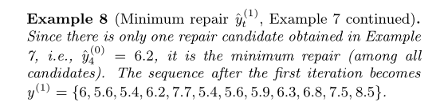
example：Repair Evaluation
y (0) = {+, +, +, 6.2, −, +, −, −, −, −, −，+}
y (1) = {6, 5.6, 5.4, 6.2, 7.7, 5.4, 5.6, 5.9, 6.3, 6.8, 7.5, 8.5}.

Slide 20
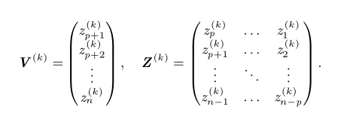
Matrix Pruning
method1：That is, most values in Z (k) and V (k) equal to 0，We show that the sparse matrices，could be pruned by removing rows with value 0.

Slide 21
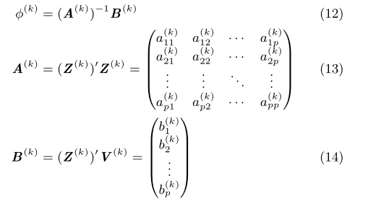
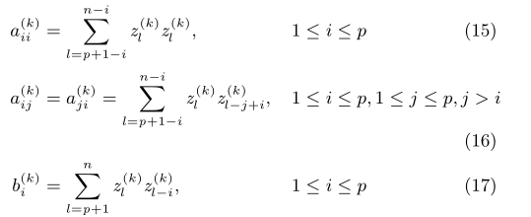

Matrix Pruning2
A(k) and B (k),with sizes p × p and p × 1, respectively, could be recursively computed from A(k−1) and B (k−1)

Slide 22
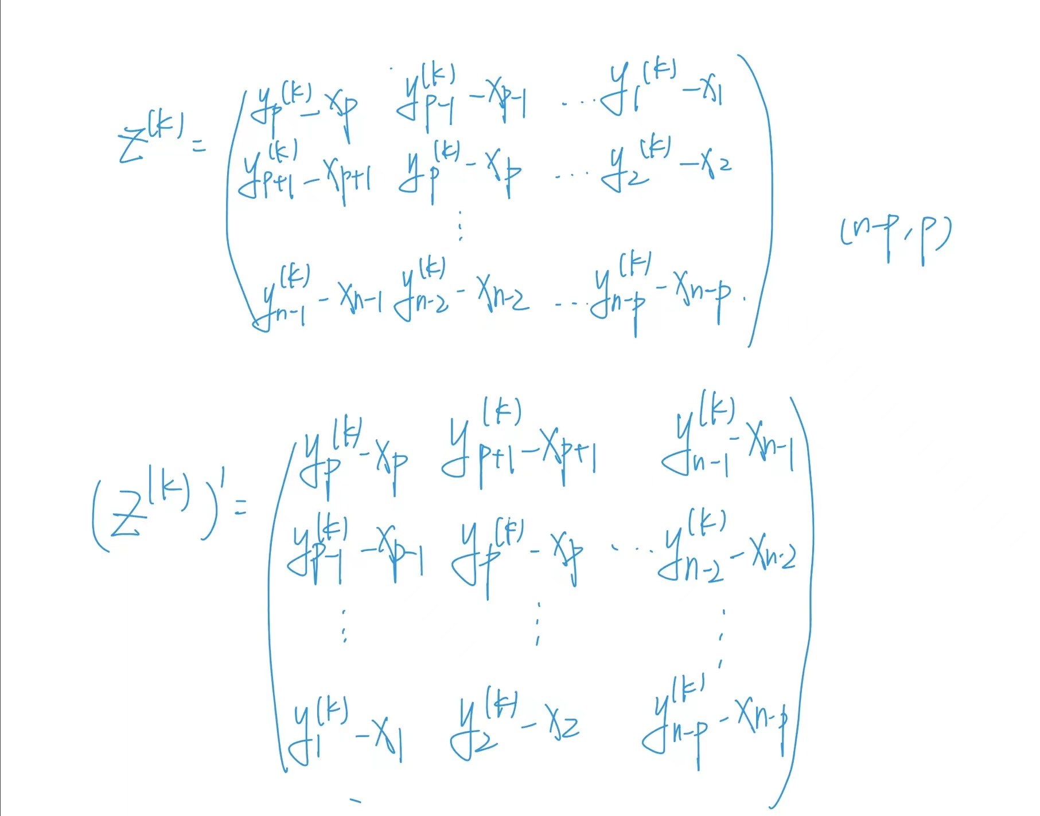
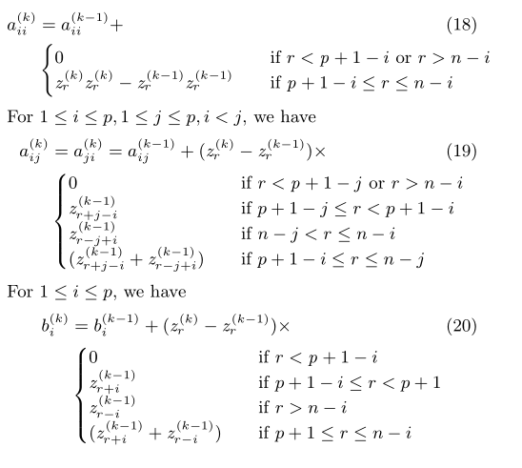
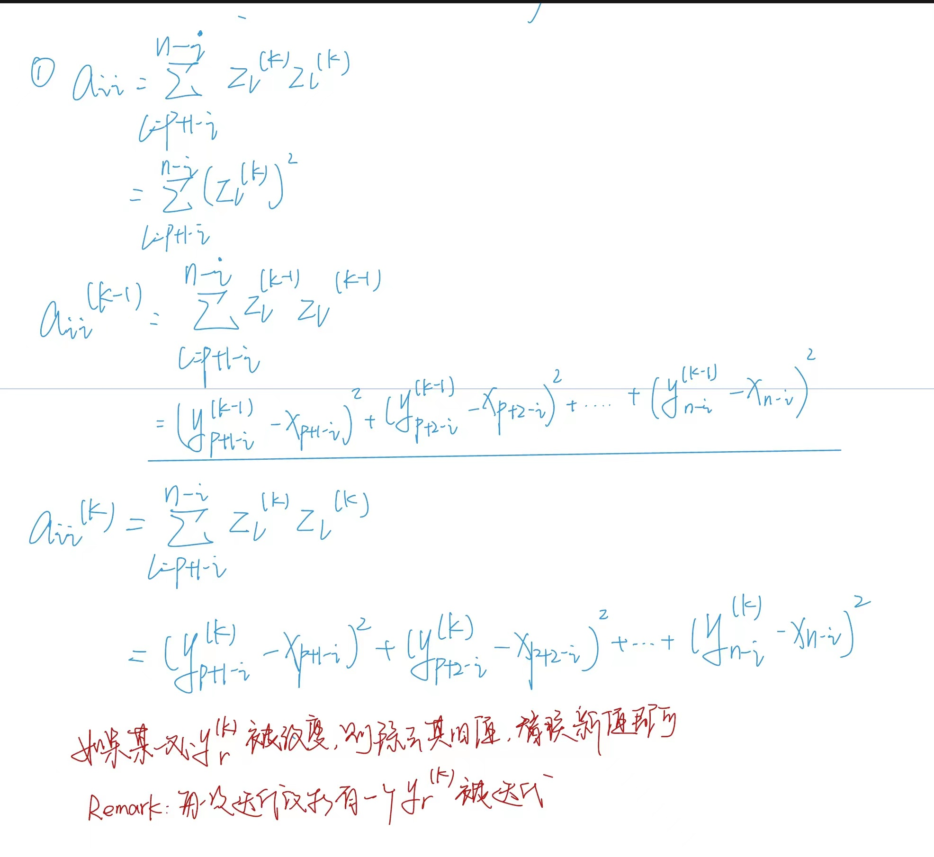
Matrix Pruning2

Slide 23
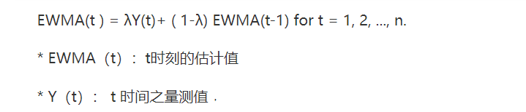
EXPERIMENT
(1) AR
(2)ARX
(3) EWMA
(4) SCREEN
(5)IMR(IMR IMR-MP IMPIC)
GPS data
person carrying a smartphone and walking around at cam-
pus. Since we know exactly the path of walking, a number of
186 dirty points out of 742 points in trajectory are manually
identified.
ILD data
54 sensors for every 31 seconds in about 38 days. Taking 31 seconds as one epoch and omitting the missing data, a dataset of 4912 points is obtained in sensor 1 from Feb 29th to Mar 1st.

Slide 24
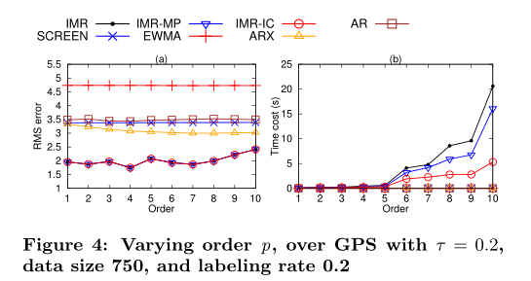
Varying P
An excessively large p, however, does not show further improvement, since this simple model may not be able to capture the complicated semantics in a large window.

Slide 25
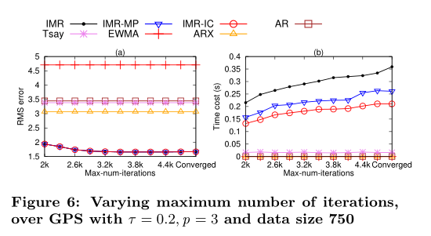
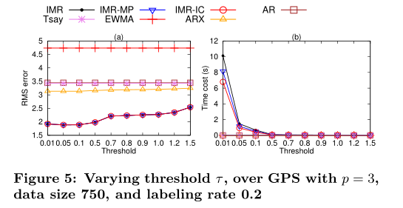
Varying Convergence Threshold τ&&maximum number of iterators

Slide 26
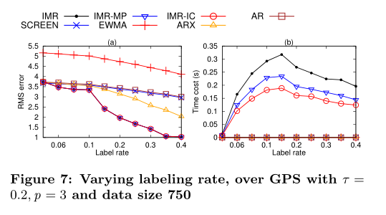
Varying labeling rate
With more data labeled in the input, more dirty points will be identified and repaired by the algorithm, leading to higher computation costs. When the labeling rate is large, such as 0.25, a great number of dirty points may be labeled. Thereby, the iterative repair could converge quickly again.

Slide 27
THANKS

